Slide 1
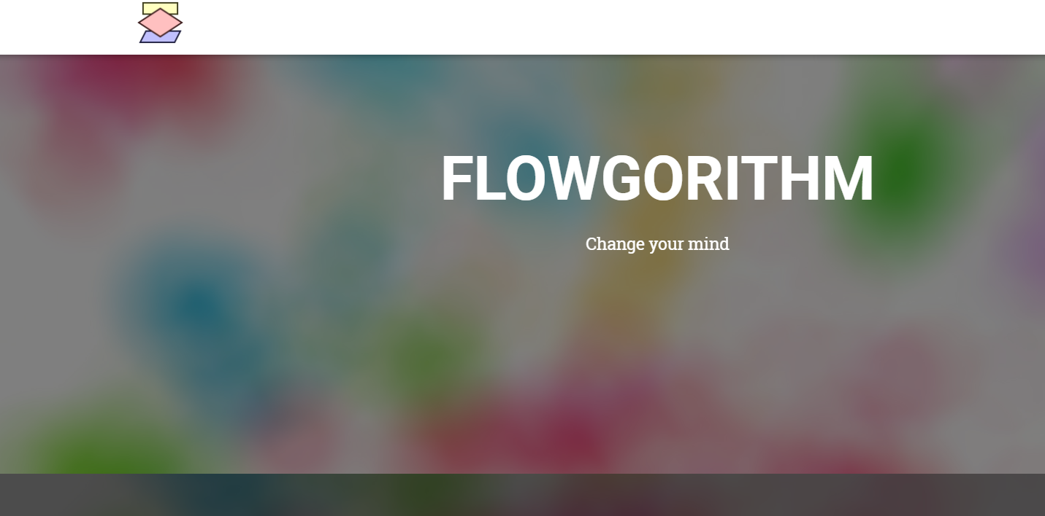
FLOWGORITHM

Slide 2
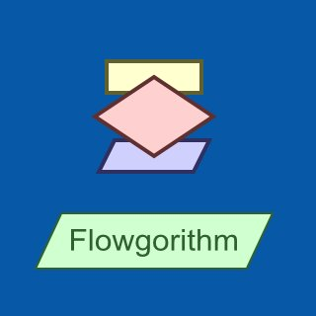


Slide 3
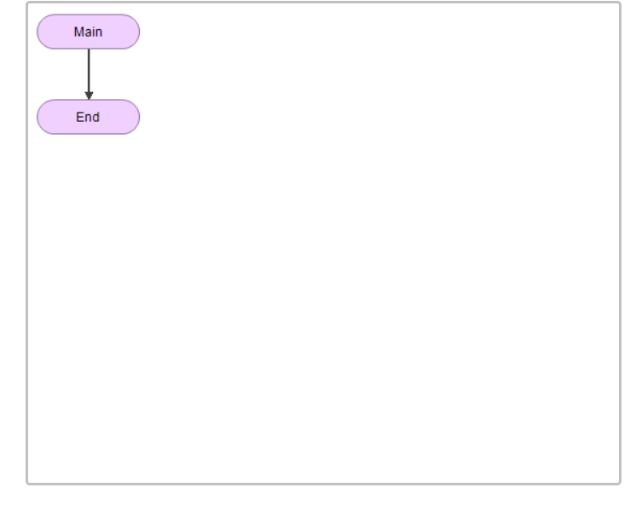
STEP 1
When you start a new flowchart, you will see two rounded rectangles called "terminals". These symbols represent the beginning and end of your program.
Many flowcharts display the text "start" in the top terminal. Flowgorithm, however, uses the text "Main".

Slide 4
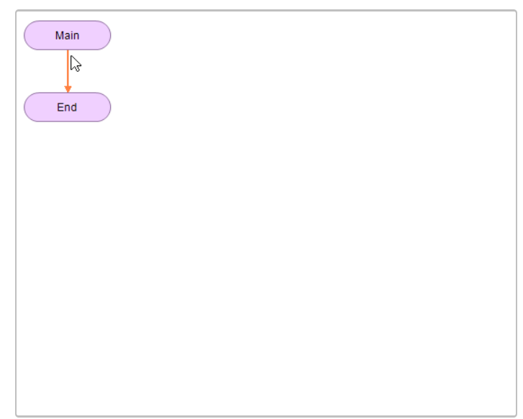
STEP 2
Everything in a flowgorithm is represented by a shape.
You will add your own shapes between the Main and End terminals.
To add a shape, move your mouse pointer over a line. If you can add a shape, the line will turn orange.
Now, either double-click or right-click to add a shape.

Slide 5
STEP 3
A pop-up menu will appear that shows all the shapes you can add.
In flowgorithm, each action your computer can perform is represented by a different shape. For example, input and output shapes are represented with parallelograms (slanted rectangles).
You can also paste from the clipboard using this menu. In the picture, it is grayed-out, so there isn't anything to paste yet.

Slide 6
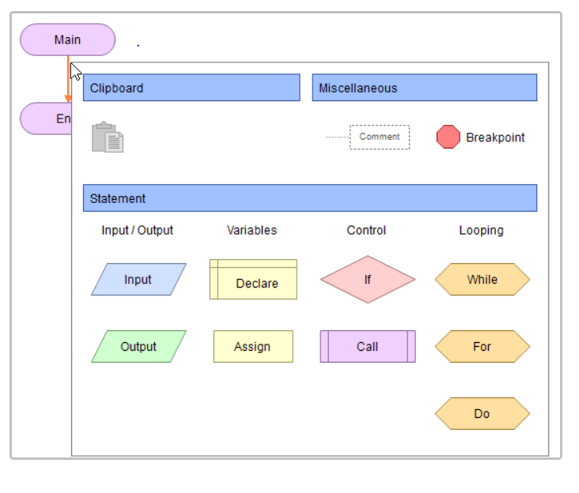
STEP 3
A pop-up menu will appear that shows all the shapes you can add.
In flowcharts, each action your computer can perform is represented by a different shape. For example, input and output shapes are represented with parallelograms (slanted rectangles).
You can also paste from the clipboard using this menu. In the picture, it is grayed-out, so there isn't anything to paste yet.

Slide 7
STEP 4
The Hello World program [to display a message] needs an output shape. It will allow the program to display information on the screen.
Move the mouse over the green parallelogram with the text "Output". It will highlight in blue.
Click on the shape. It will be added to your flowchart.

Slide 8
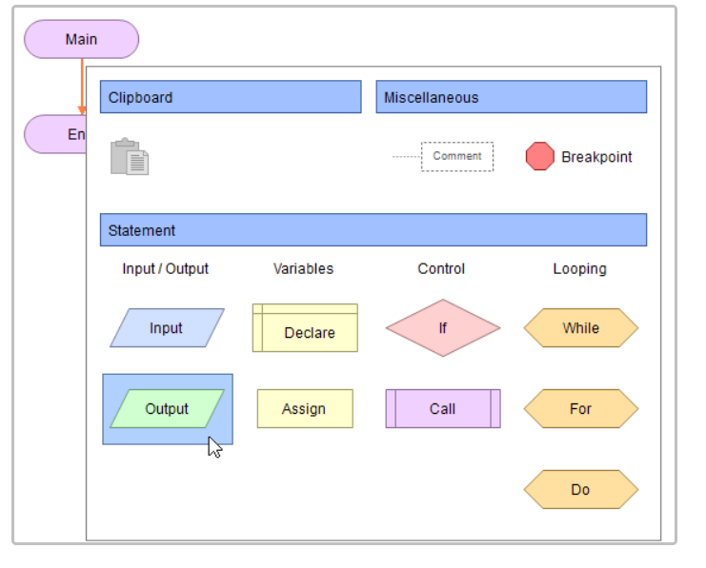
STEP 4
The Hello World program [to display a message] needs an output shape. It will allow the program to display information on the screen.
Move the mouse over the green parallelogram with the text "Output". It will highlight in blue.
Click on the shape. It will be added to your flowchart.

Slide 9
STEP 5
A window will appear titled "Output Properties". Using this window, you can specify what will be displayed on the screen.
Output shapes are fairly simple. They will output the result of an expression. This can be something like a text message, a variable, or the result of a calculation.
In the box, type "Hello, world!". You have to add the double-quotes around the text. In computer programming, this is called a String.
Now, click on OK to continue. You might get an error window if you didn't type it in correctly. If that happens, just edit the shape again and fix it.

Slide 10
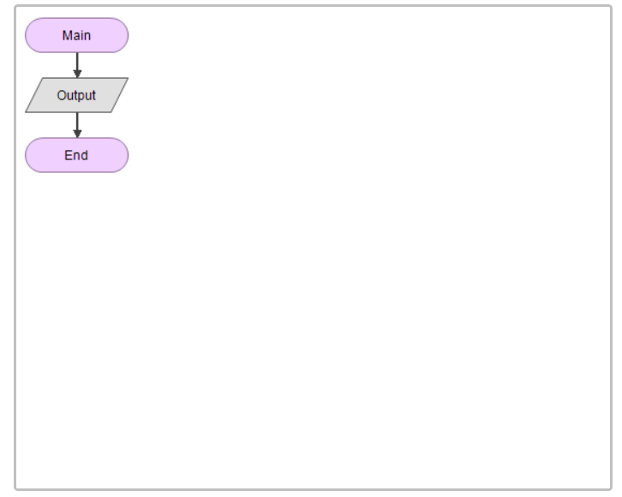
STEP 5
A window will appear titled "Output Properties". Using this window, you can specify what will be displayed on the screen.
Output shapes are fairly simple. They will output the result of an expression. This can be something like a text message, a variable, or the result of a calculation.
In the box, type "Hello, world!". You have to add the double-quotes around the text. In computer programming, this is called a String.
Now, click on OK to continue. You might get an error window if you didn't type it in correctly. If that happens, just edit the shape again and fix it.

Slide 11
STEP 6
Now your flowchart contains an output shape.
Currently, it is displayed in gray. In Flowgorithm, any shape that is gray is "incomplete". This means that the shape needs some information before it can work.
You need to tell Flowgorithm what you want it to output. This can be anything from the result of a calculation to a text message.
Now, double-click or right-click on the output shape to edit it.

Slide 12
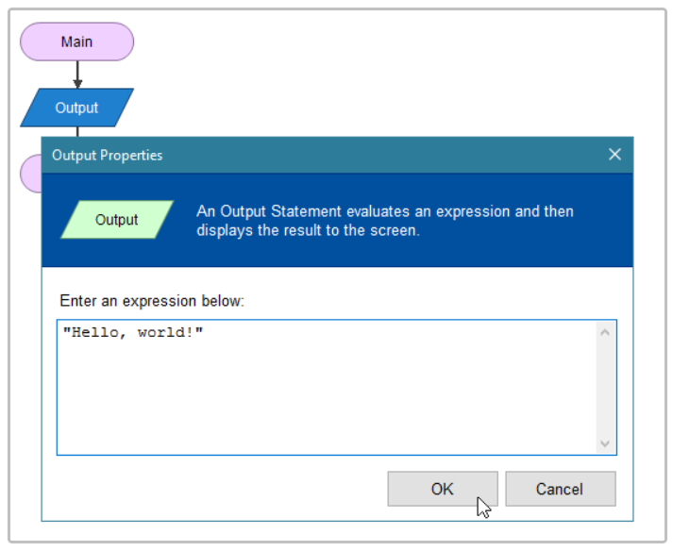
STEP 6
Now your flowchart contains an output shape.
Currently, it is displayed in gray. In Flowgorithm, any shape that is gray is "incomplete". This means that the shape needs some information before it can work.
You need to tell Flowgorithm what you want it to output. This can be anything from the result of a calculation to a text message.
Now, double-click or right-click on the output shape to edit it.

Slide 13
STEP 7
The Output shape will now appear in green.
Since all the shapes are in color (nothing is gray), your program is complete. Now it is time to run it.
On the main toolbar, you should see a green icon that looks like the Play Button you use when playing a DVD or watching a video on YouTube.
Click on this icon to run your program. You can also press F5 on your keyboard or select Run from the Program menu.

Slide 14
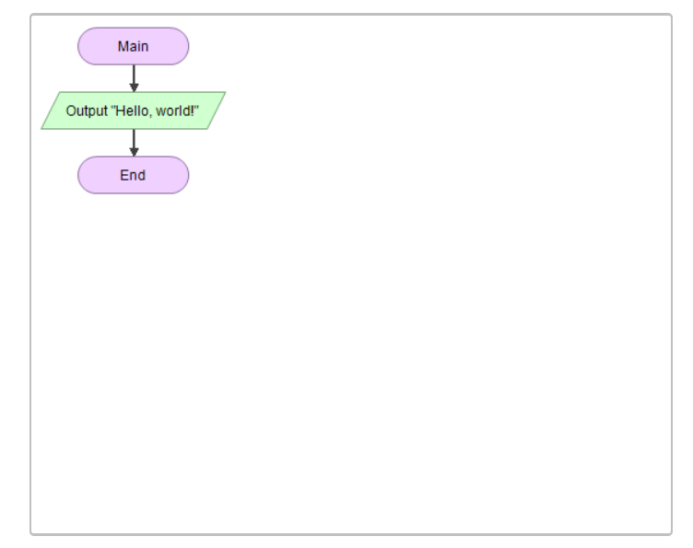
STEP 7
The Output shape will now appear in green.
Since all the shapes are in color (nothing is gray), your program is complete. Now it is time to run it.
On the main toolbar, you should see a green icon that looks like the Play Button you use when playing a DVD or watching a video on YouTube.
Click on this icon to run your program. You can also press F5 on your keyboard or select Run from the Program menu.

Slide 15
STEP 8
A new window should appear called the "Console Screen". In computer programming, the console is used to display and input textual information.
The Console Screen in Flowgorithm was modeled after the texting windows you use on your phone. So, it is like you are texting Flowgorithm!
Anyway, you have finished your first computer program. Congratulations!

Slide 16
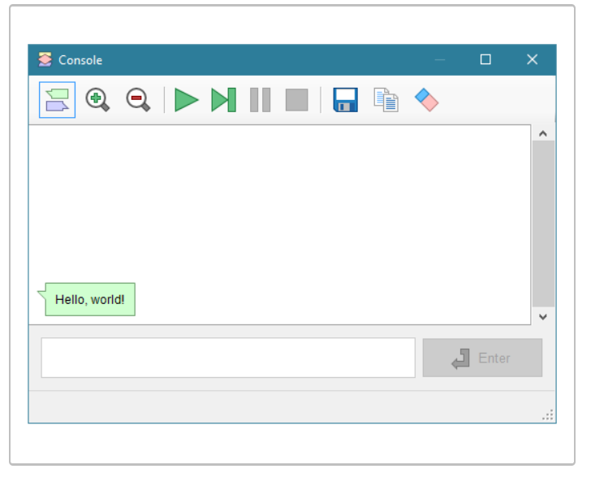
STEP 8
A new window should appear called the "Console Screen". In computer programming, the console is used to display and input textual information.
The Console Screen in Flowgorithm was modeled after the texting windows you use on your phone. So, it is like you are texting Flowgorithm!
Anyway, you have finished your first computer program. Congratulations!

